Slide 1
WELCOME

Slide 2
WELCOME

Slide 3
Zermatt at a glance
Zermatt is car free
365 days a year
more than 400 km of hiking trails
more than 360 km
of ski runs
high quality gastronomy
more than 13‘700 guest beds
more than 1.6 m. overnight stays
Label „Family Destination“
living traditions & Swissness
over 80% regular guests

Slide 4
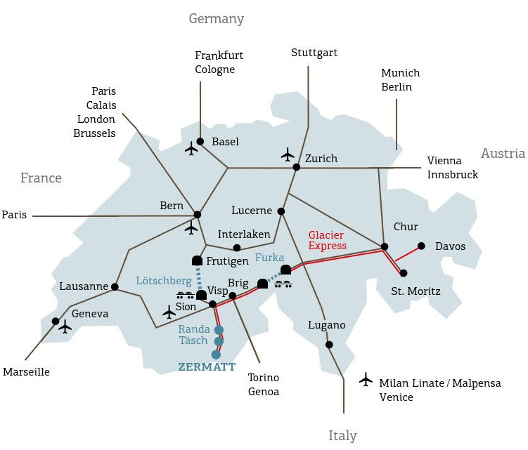
LOCATION & ARRIVAL

Slide 5
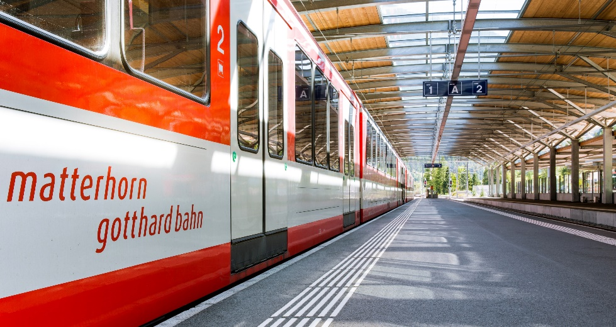
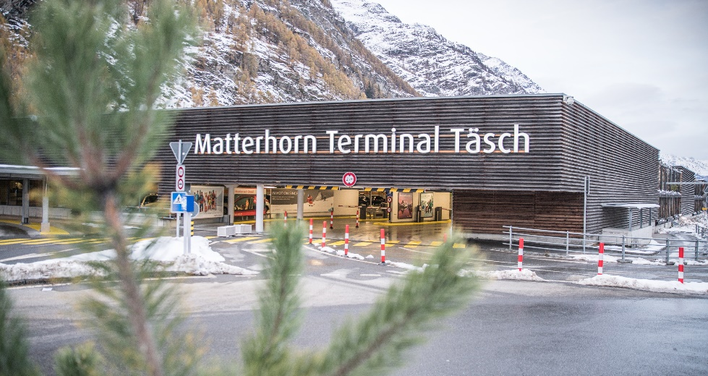
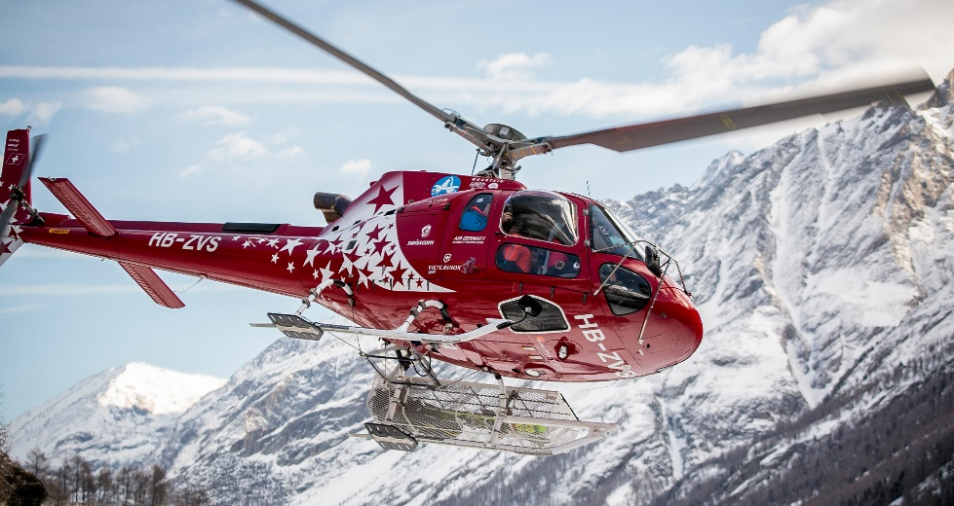
Getting to Zermatt
Zermatt has always been car free.
There are several ways to get to Zermatt:
By plane (arrival possible via various airports).
By car (onward journey by shuttle train or taxi from Täsch, 5 km from Zermatt)
By train - on the Glacier Express train or Matterhorn Gotthard Bahn rail links
By helicopter

Slide 6
IN 1961, THE COUNCIL DECIDES TO REMAIN CAR-FREE

Slide 7
hISTORY

Slide 8
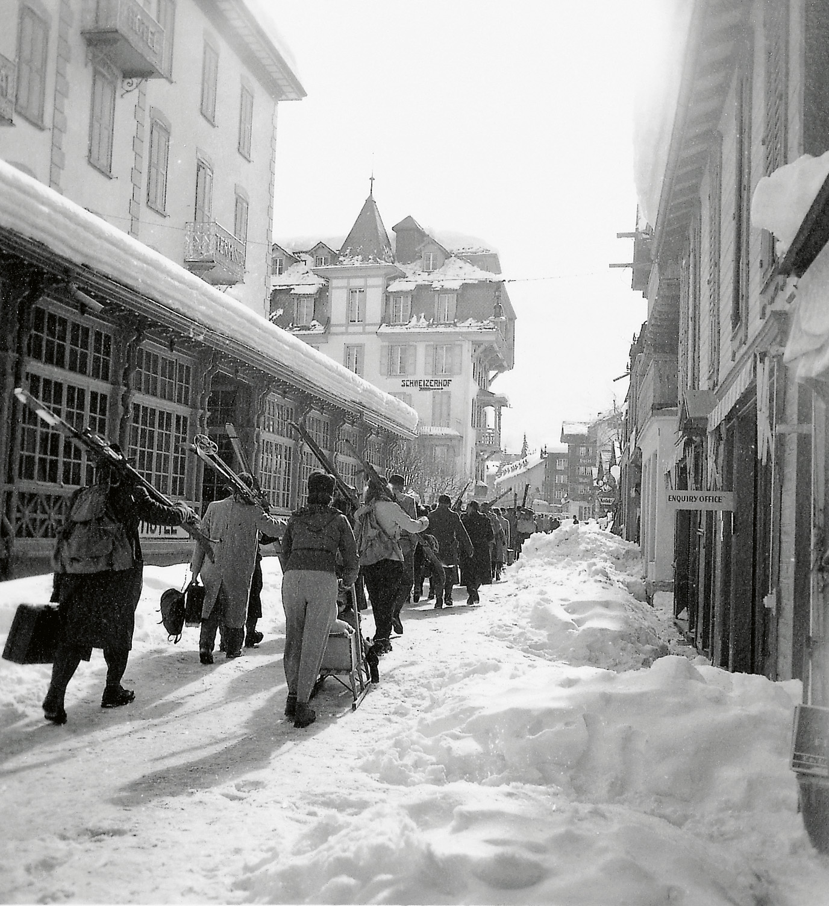
hISTORY / Milestones
1756  First tourist in Zermatt
1839  Opening of the first hotel (Monte Rosa) in Zermatt
1865  The first ascent of the Matterhorn on 14th July 1865
1891  First train to Zermatt
1898  The Gornergrat Bahn (rack railway) is running
for the first time
1928  First winter season
1961  The council decides to stay car-free
2015  Jubilee year: 150 years first ascent of the Matterhorn
2018  Inauguration of the world‘s highest 3S cableway
2023  Coming soon 2023: Matterhorn Alpine Crossing

Slide 9
THE FIRST ASCENT OF THE MATTERHORN ON 14TH JULY 1865…

Slide 10
… ENDED IN A TRAGEDY WHICH MADE ZERMATT WORLD FAMOUS OVER NIGHT.

Slide 11
Unique destination

Slide 12
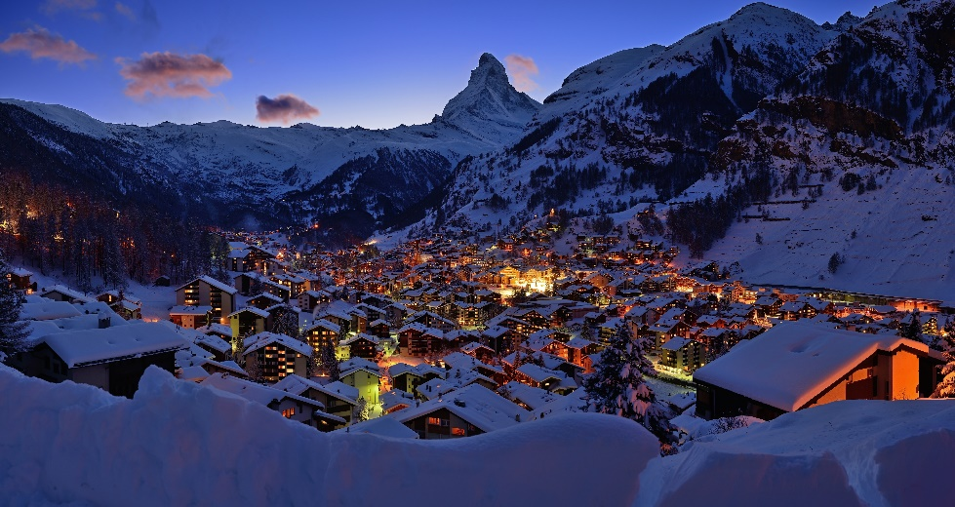
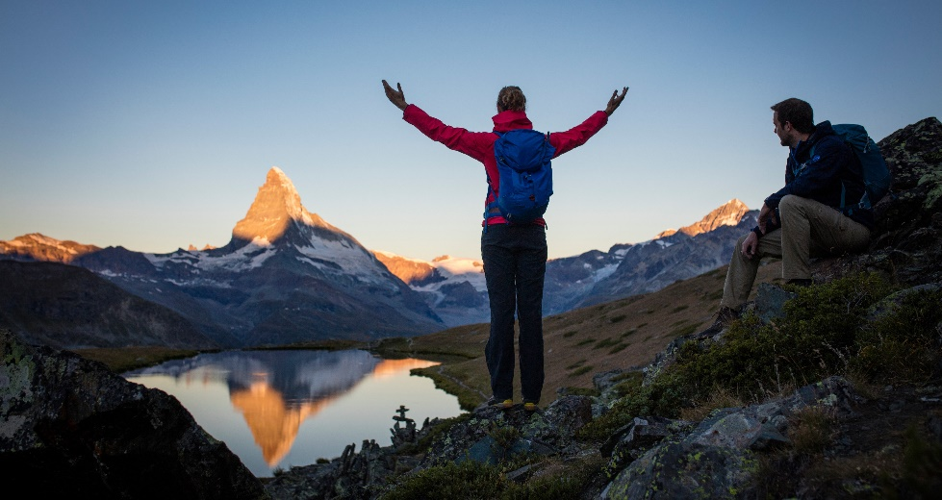
Unique destination
Matterhorn (4,478 m)
Zermatt (1,620 m) is car-free
365 days of guaranteed snow and piste enjoyment
Unlimited winter and summer adventures and experiences
55 bars and 118 restaurants in the village plus 49 mountain restaurants
107 hotels (with over 7,000 beds) and over 1,100 holiday apartments (with around 4,600 beds)
Authentic and tradition-rich village-scape with a great deal of Swissness

Slide 13
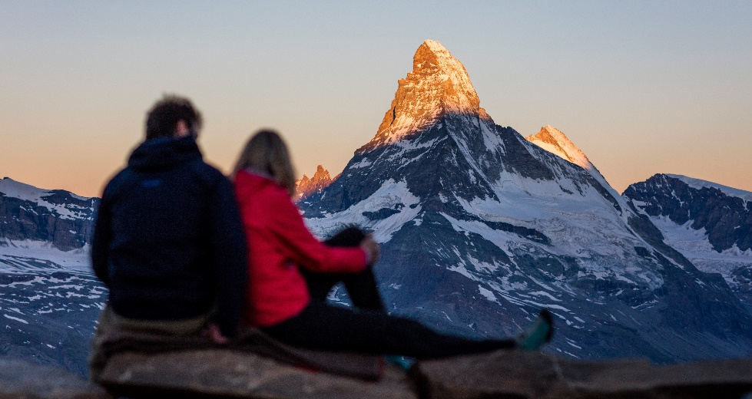
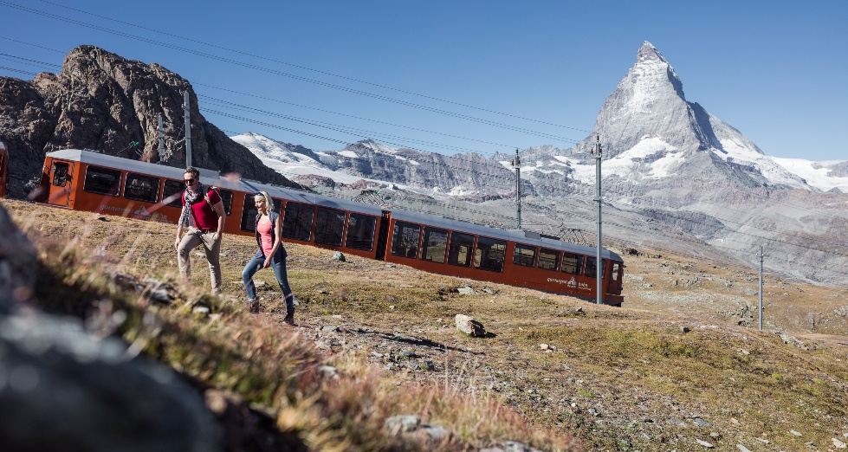
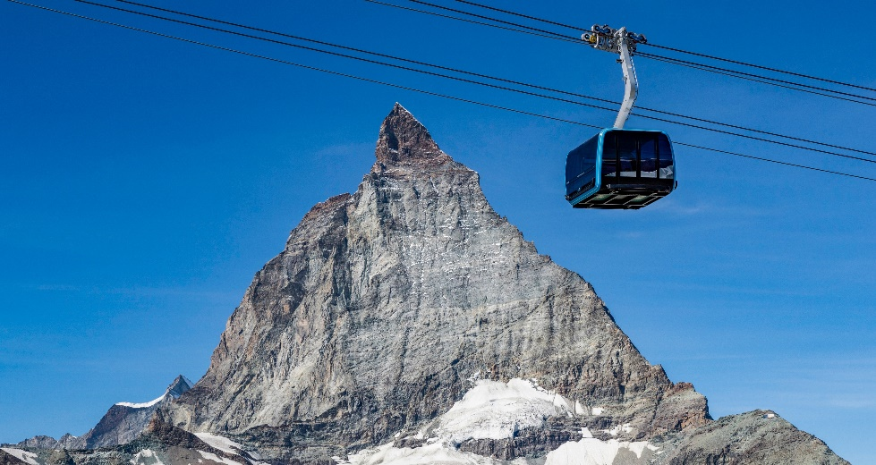
Unique Matterhorn
Matterhorn Glacier Paradise (3,883 m) with the highest viewing platform in Europe
Crystal Glacier Ride to the Matterhorn Glacier Paradise
Gornergrat (3,089 m) with a view of the world of glaciers and mountains
Rothorn (3,103 m) with a view of a breathtaking mountain panorama and the classic view of the Matterhorn
Mountain panorama with 38 four thousand-metre peaks and glaciers
Helicopter sightseeing flights around the Matterhorn
Mirror image of the Matterhorn in the lakes, magical sunrises and sunsets

Slide 14
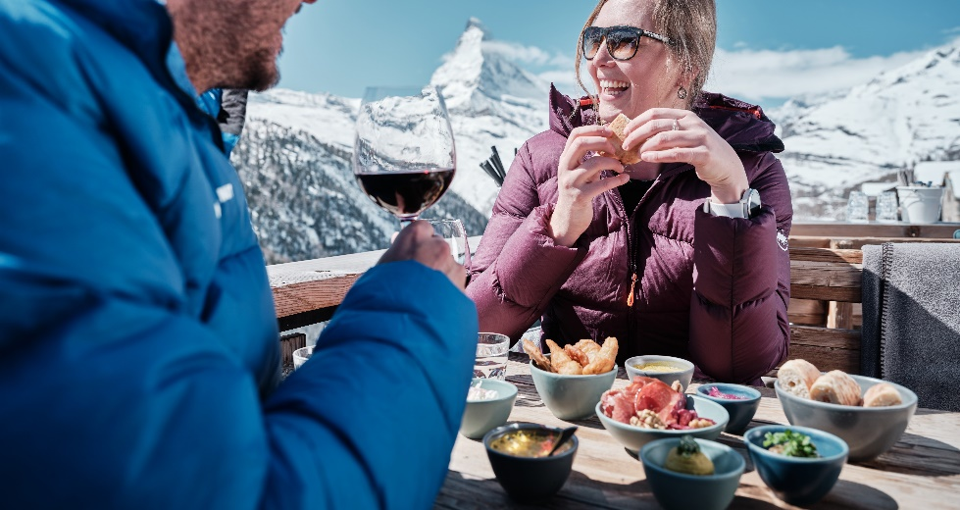
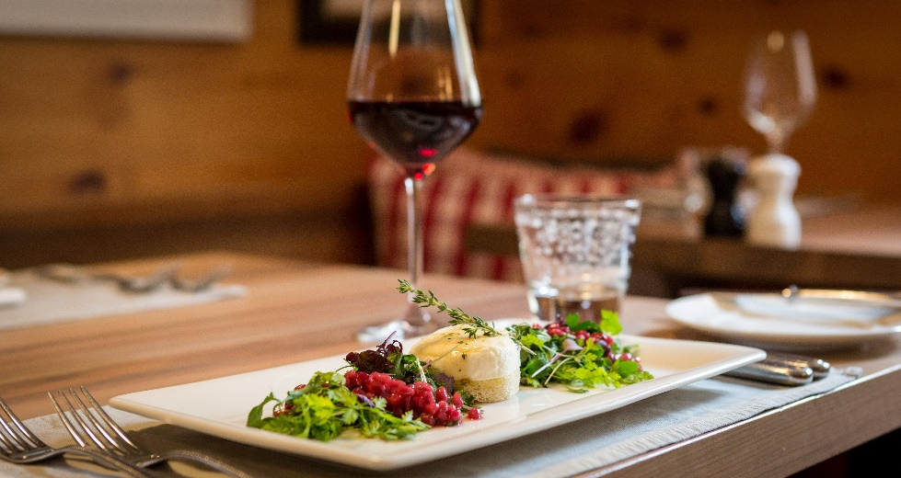
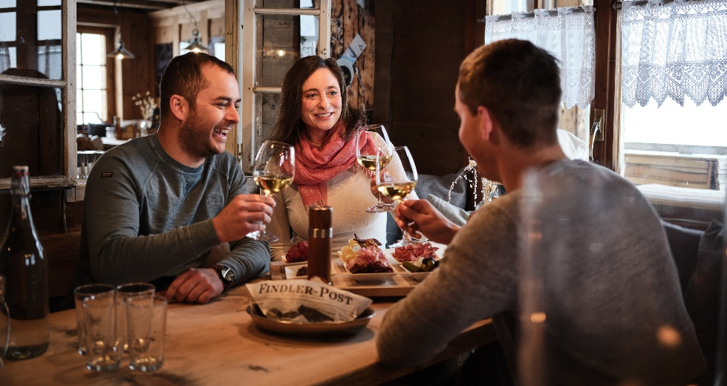
Unique culinary delights
The choice is huge, from traditional dishes to the latest creations
Multiple restaurants with Gault Millau or Michelin awards
Regional products, such as:
Valais dish with dried meat and Hobelkäse (planed cheese)
Cheese fondue and Raclette in many variations
Different kinds of bread including traditional rye bread
Zermatt beer
Valais wines from the region with autochthonous grape varieties

Slide 15
Winter

Slide 16
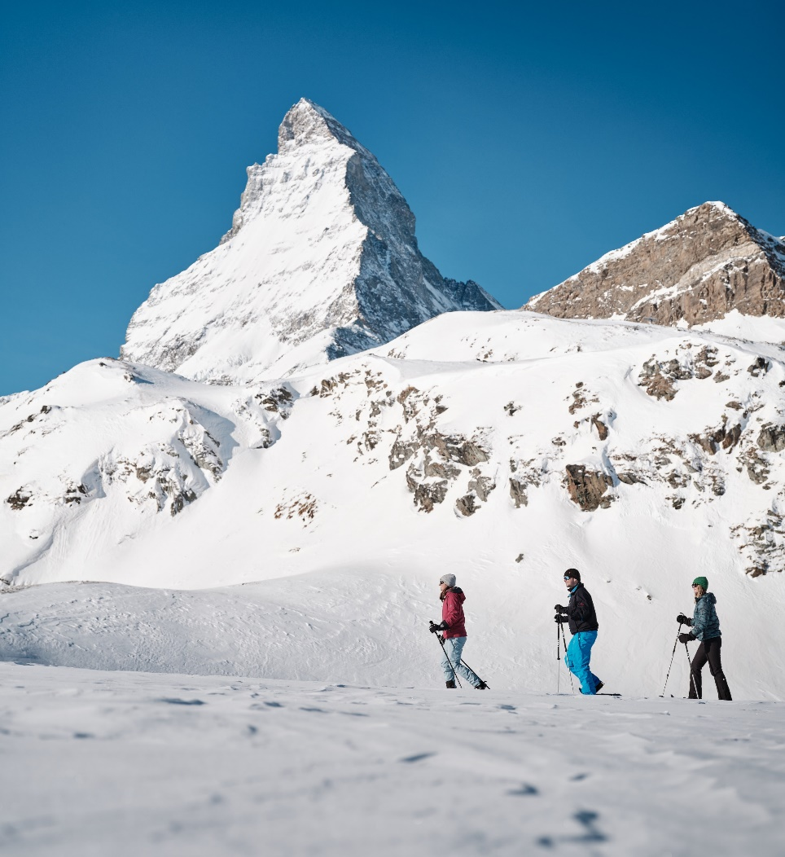
MOUNTAIN ADVENTUREs IN WINTER
360 km of pistes (incl. Cervinia, Italy)
Over 21 km of pistes in summer on Matterhorn Glacier Paradise
Ski touring
Snowshoe hiking
Winter hiking
Sledging
Ice skating
Cross-country skiing
Igloo-village
Husky sleigh rides
Sightseeing flights and Heli skiing
… and a lot more

Slide 17
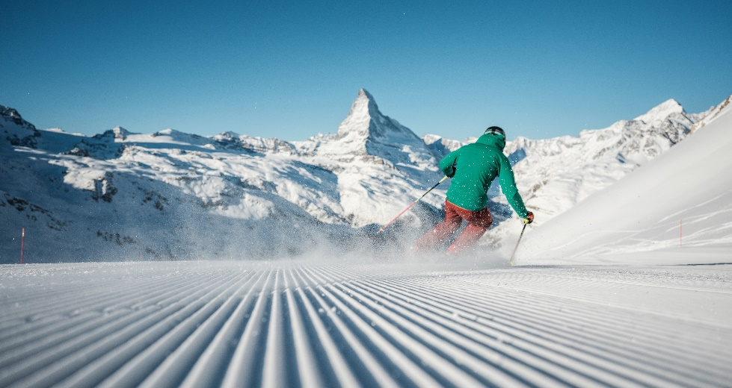
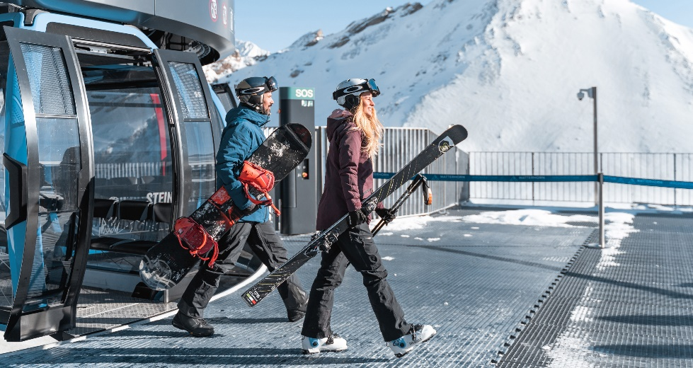
Unique ski area
360 km of top-prepared pistes with international connection to Italy
Snow certainty (75% ski runs and pistes with artificial snow or on glacier)
Comfortable transportation with no waiting time
At 25 km, the longest downhill run in Europe
Beginner parks
Comfortable mountain restaurants
Legendary après ski scene
Special offers such as Matterhorn Ski Safari, moonlight descents, First Track etc.

Slide 18
Matterhorn ski paradise: 360 km

Slide 19
Summer

Slide 20
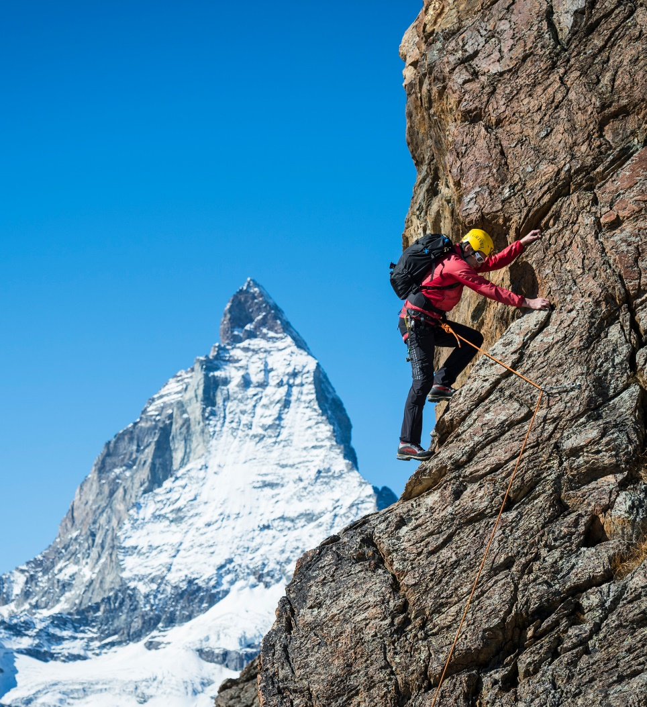
MOUNTAIN ADVENTURE IN SUMMER
3 Peaks
400 km of hiking trails
Summer skiing with 21 km
Mountain biking & Flowtrails
Mountaineering and easiest 4,000 m peak
Funventure outdoor activities like kickbikes, dirt scooters and mountain cartsGolf
Paragliding
Sightseeing flights Air Zermatt
Via ferrata
Forest Fun Park
Shopping
Breithorn – the easiest 4000 m ascent in the Alps
… and a lot more

Slide 21
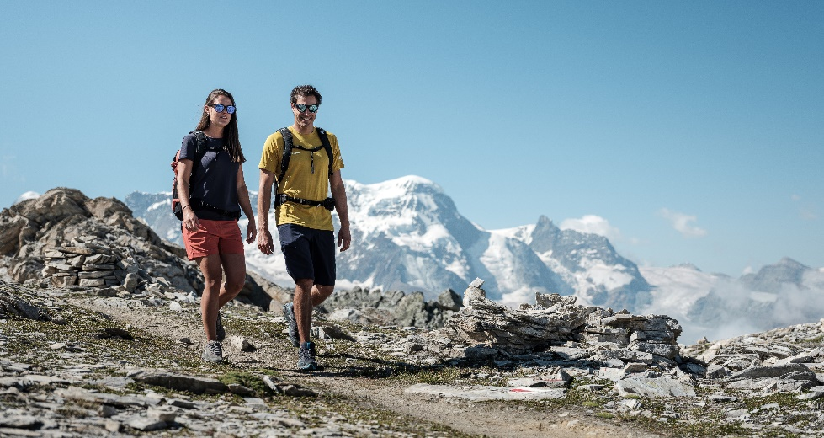
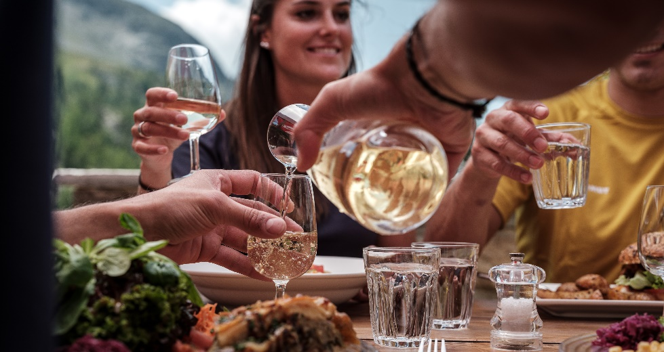
Unique Hiking area
400 km of well-marked hiking trails
Varied theme paths
First-class mountain cuisine
Great variety of natural attractions (mountain lakes, gorges, mountain meadows)
Overnight stay opportunities in the mountains
Multi-day tours and hut trekkings
Unique flora and fauna
Longest pedestrian suspension bridge in the Alps

Slide 22
Hiking paradise: 400 km

Slide 23
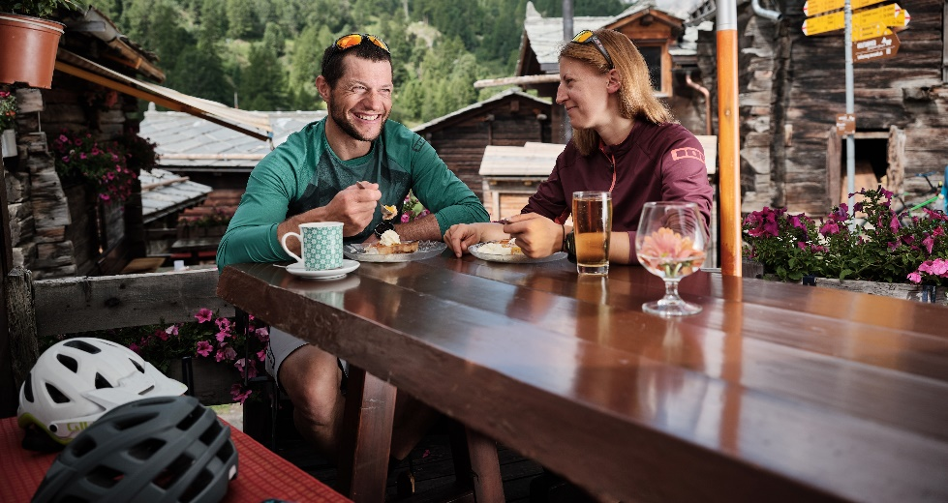
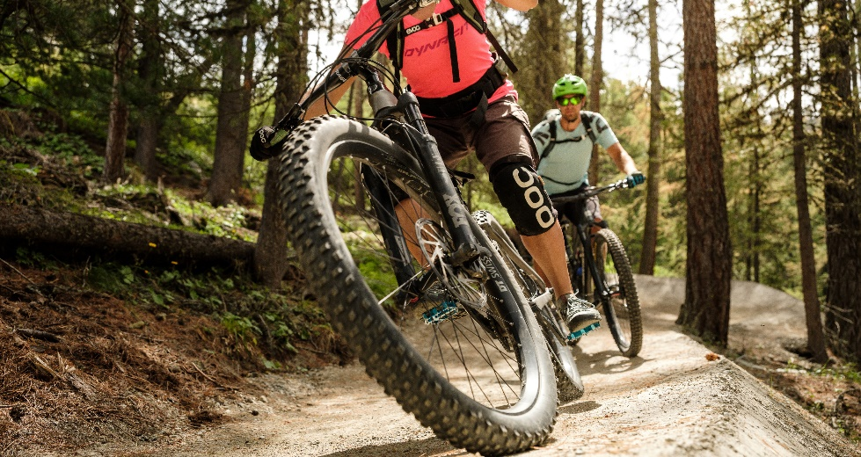
Unique Mountain Bike area
Over 200 km of well-marked mountain bike trails with different levels of difficulty
Bike friendly infrastructure (transportation, accommodation)
Moos-Trail, the easiest flow trail in Switzerland
Bike tours with up to 1,700 m altitude difference
Heli biking (helicopter flight combined with a breathtaking downhill ride)
Certified bike hotels and holiday apartments
Competent bike schools and knowledgeable local bike guides

Slide 24
Families & wolli

Slide 25
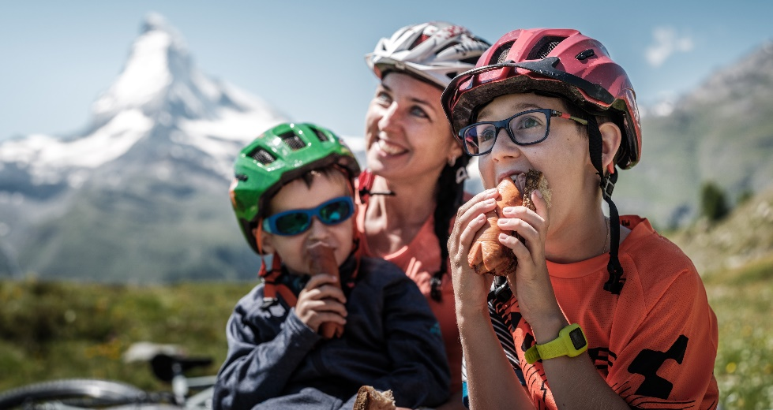
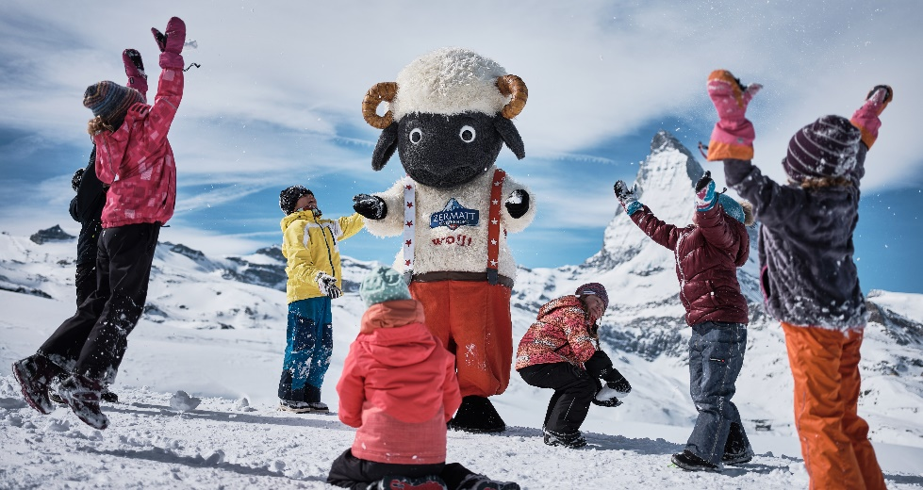
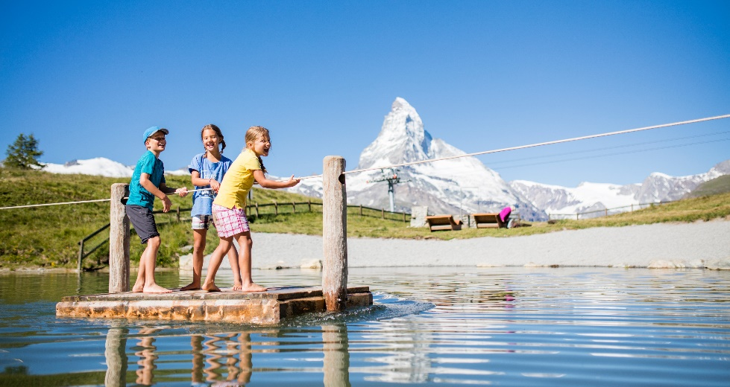
Unique Offers for families
Winter offers:
Winter activities in the village (ice skating, playground, riddles etc.)
Snowpark with kickers, half pipe and beginners' parks
Children up to the age of 16 ski for free on Saturdays
Summer offers:
New from summer 2023: Wolli Wonderland (mountain playground with puzzle game)
Wolli adventure park at Leisee with swimming fun, playground, water games
Countless playgrounds and fireplaces
Animation programme for children
Adventure offers (Gorner Gorge, Forest Fun Park, climbing, flowtrails etc.)
All year round:
Seal of quality «Families welcome»
Wolli Card for children up to 9 years
With the Wolli Card, children up to the age of 9 can use all cable cars free of charge. They can also stay overnight for free in their parents' room or with an extra bed in numerous accommodation options. Children don’t pay visitor's tax and benefit from other advantages.

Slide 26
Events

Slide 27
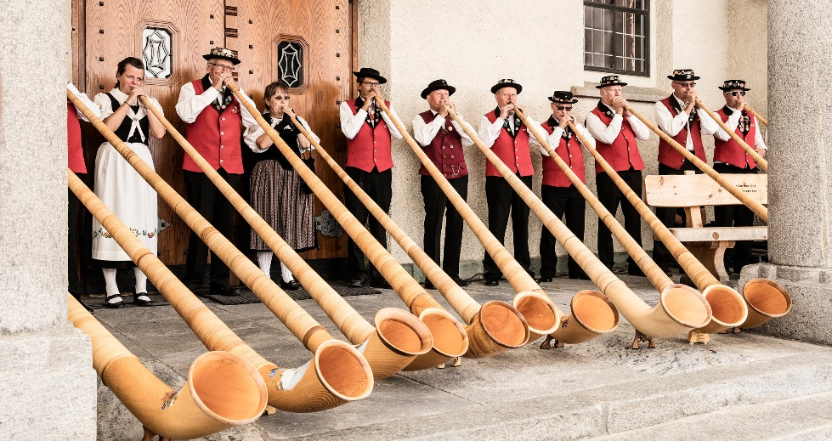
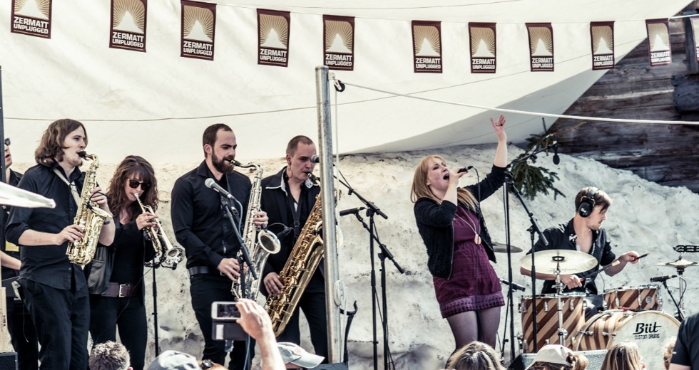
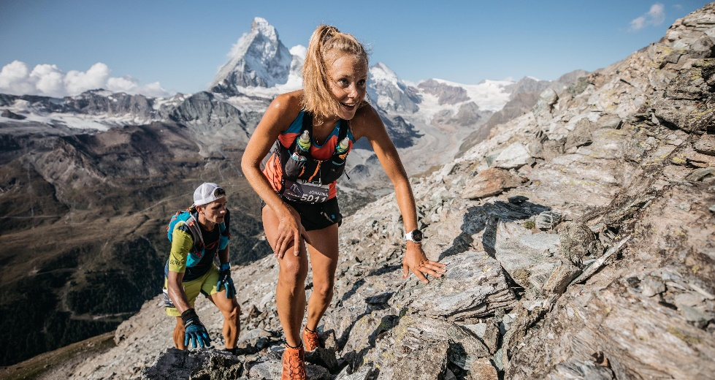
Unique Events
Summer
Gornergrat – Zermatt Marathon
1st August Swiss National Holiday
Täschalp Run and Sheperd Festival
Folklore Festival
Matterhorn Ultraks – Trail
Sheperd Festival (Wollis anniversary)
Zermatt Music Festival & Academy
Taste of Zermatt
Winter
Horu Trophy – Curling tournament
Zermatt Unplugged
Patrouille des Glaciers
Matterhorn Cervino Speed Opening
… and a lot more

Slide 28
THANK YOU VERY MUCH FOR YOUR ATTENTION

Slide 29
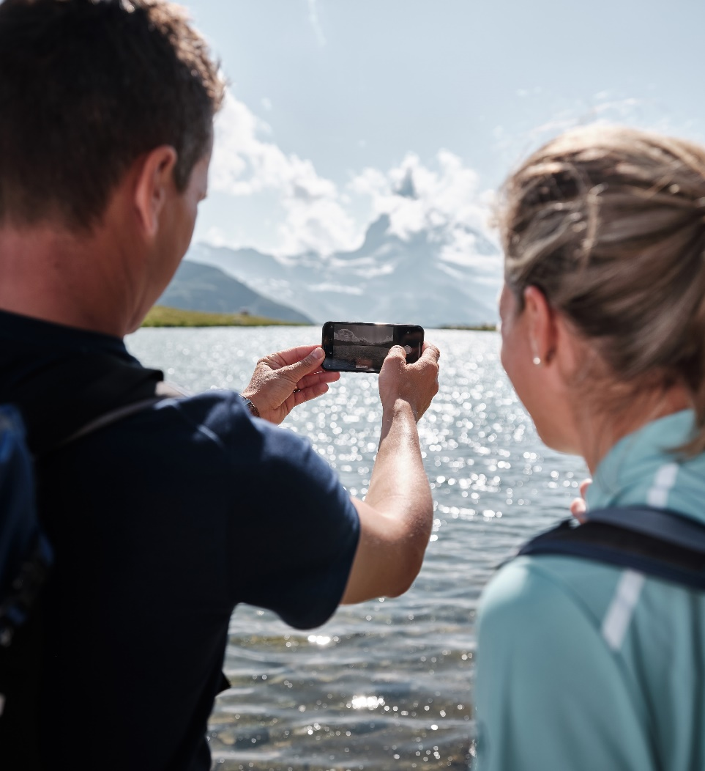
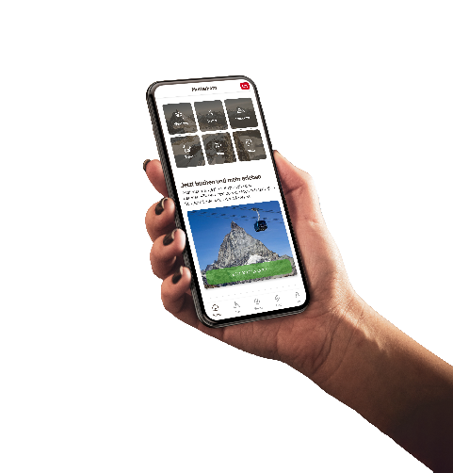
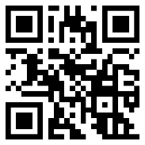
Always up-to-date
With our social media channels
www.zermatt.ch/en/get-connected
#zermatt #matterhorn
Or with the Matterhorn App
(available for iOS and Android)
www.zermatt.ch/en/Matterhorn-App
Download now
+41 (0)27 966 81 11
marketing@zermatt.swiss
www.zermatt.ch/en

